Slide 1
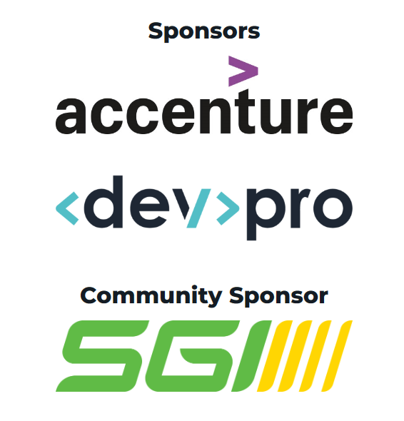
Foundations of Using Cost as an Architectural Fitness Function
With support from
Prairie Dev Con Regina
Dale Birtch
Notes:
This concept first appeared on the thoughtworks technology radar in 2018 as a “trial” state - its since been recommended as a practice to adopt, i’d like to show you a bit about how i think about architecture and encourage you to evaluate the pain points in your own systems.
https://www.thoughtworks.com/en-ca/radar/techniques/run-cost-as-architecture-fitness-function

Slide 2
About me
Travelled from Saskatoon
Work in SAAS - Currently Engineering manager
Have a passion for reliability and building for scale
Notes:
There won’t be a test on any of these points - but there may be on the next slide

Slide 3

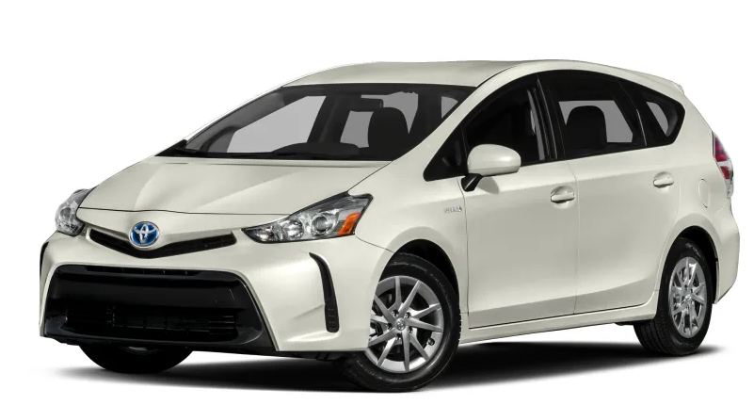
What car is better?
Notes:
Answering this question is no different than spitballing about architecture options or whats the better cloud provider - Without knowing the job to be done and requirements there is no right choice, if the job to be done is getting a date, or heading to a track day one choice may be obvious, but if the task at hand is picking up a family at the airport there is a more clear and obvious choice.

Slide 4
Understanding business context is the most important step in making architecture decisions
Notes:
Story time - Lead with a point where i didn’t understand business context and really believed there were meaningful opportunities to cut costs.
I was 20, working for Agfa doing field service on their Picture archive and communication systems (PACS) network - we were installed across 21 facilities in Northern Ontario - each site had at least 3 servers, a couple workstations and some higher end display stations. About 150 Dell devices under management.
In a 1-1 my manager asked if i had anything else on my mind - “i think we could save 50 grand” - How do you suppose we do that? - We’re purchasing service contracts on all this hardware - 4hr parts, next day onsite service - and they rarely have failures, A couple disks, maybe a hot spare or 2 and we could ditch that line item,
“If everyone thought like that - you wouldn’t have a job” was his reply.
He went on to explain how those service contracts are insurance against bad batches of parts, they buy us breathing room with the customer to deflect, they manage the maximum impact of downtime for the customer. In fact its the exact same model that pays my salary - We installed 15 million dollars worth of equipment, a mix of xray digitizers, storage, and servers - this had an upfront cost, but also a contract for onsite support for the next 5 years - 10% is the standard annual rate for this type of support. After 5 years the service contract will likely renew - but we’ll refresh the dell’s and increase the % charged for the older x-ray gear, and this repeats until the expected lifespan.
Who here is familiar with the technology Radar from thoughtworks.
https://www.thoughtworks.com/en-ca/radar

Slide 5
Technology radar - 2018 - Trial
Teams aren’t tracking spend as closely as they should
An unsafe assumption that serverless provides lower costs
Need to track cost against running value provided
Notes:
https://www.thoughtworks.com/en-ca/radar/techniques/run-cost-as-architecture-fitness-function

Slide 6
Technology radar - 2019, 2020 - Adopt
Estimating and projection spend is necessary
Dynamic nature changes cost through the lifetime of apps
Spot deviations from expected and adjust architecture
Notes:
https://www.thoughtworks.com/en-ca/radar/techniques/run-cost-as-architecture-fitness-function

Slide 7
Technology radar - 2023 - Adopt
Complex pricing models can lead to surprising cloud bills
Platforms and reporting exist for business leaders
Most consumption decisions happen in engineering
Notes:
Quick story on surprising behaviour - Abuse case on e-mail builder send preview, attacker attempted to use the send preview endpoints to send about 300,000 emails, cloud datastore holds our account data, this is a nosql database, with eventually consistent properties - so it has a limit of updating a single entity at a rate of about 1 per second - when failing it throws a contention error. These 300,000 e-mails were for the same account, they queued cloud tasks to perform the delivery - these tasks would attempt their transaction, most would fail with contention then retry - Billions of times - Datastore pricing is based on requests, this quickly ramped to tens of thousands of dollars in unexpected expenses.

Slide 8
Defining architecture
Language
Structure of the application
Environment that its served from
Notes:
Languages all have tradeoffs
Python may be great for prototyping and feature development, but have more common bugs than a statically typed language
Golang may be more performant - but GRPC and proto overhead may add too much extra work for an early organization
Haskell or Rust may be fun for projects, but difficult to hire and onboard for
Structure of the application
Most large organizations have gone the path of microservices, do you start there? Has that fad passed?
Do you split the frontend from the backend?
How do you store and access data within your application?
Environment
Physical devices?
Virtual machines?
Containerized?
Single node? Load balanced?
Application platform?
Cloud function/run?
Kubernetes?

Slide 9
Defining costs
Resources
Time
Opportunity Costs
Notes:
Resources
Physical servers, switches, disks etc
VM’s
Application platform quotas or counts
Bandwidth
Operations tooling
Cost models - some outright don’t work for your business (IE anything on a per user license doesn’t work for Vendasta)
Time
Software development time
Operations time
Scaling, provisioning
Patching
Opportunity costs
What could you be doing with more time?
Efficiency of limited resources, alignment with company needs.
Automation and increases in performance over time

Slide 10
How do i know if my costs are appropriate?
Margins
Proportion to value delivered
Divergent from customer growth
Notes:
Margins are key - SAAS these are typically targeting 85% - generally a number under 65% would be concerning and a key indicator that something needs to change
People related products 30%
Proportional to value delivered - Twitter endpoints is a recent example.
Over time you should become more efficient - if your costs scale 1:1 with customer growth this is an indicator that your architecture isn’t scaling appropriately - Over time your cost per incremental account added should continually approach zero.

Slide 11
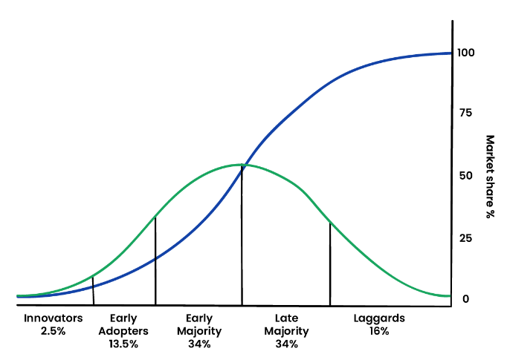
Product growth models
Notes:
Where your product exists in this graph will largely dictate your priorities from a cost and architecture aspect.
To define stages of growth I like to use the model of a customer adoption curve Diffusion of Innovation Theory
https://www.ou.edu/deptcomm/dodjcc/groups/99A2/theories.htm#:~:text=Innovators%20are%20the%20first%202.5,are%20called%20the%20early%20majority.
While this is likely far from accurate, i find it useful in considering how technology needs change alongside the significant shifts in the customers you’re attracting and their expectations from the product
Lets talk early market - This is where you’ll solidify key decisions that influence Language recommendations
Structure of the application Environment served from

Slide 12
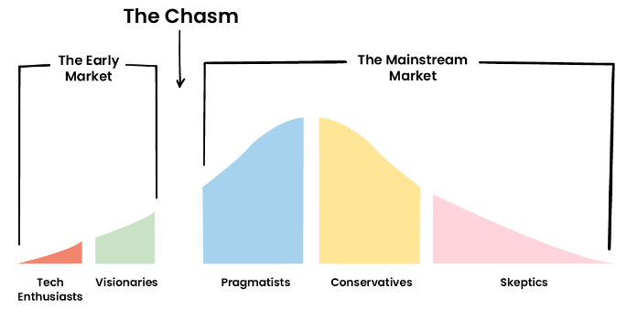
Significant needs change within the Chasm
Notes:
The transition from what the early market will accept to the mainstream is significant - your early choices may help or hinder the ability to make this jump
Starting at the beginning - You have an idea, project, potential business - where should you start architecturally - You likely don’t have revenue, so the technology choices you approach should be simplified - The customer profile of early adopters guides that they “get it” generally have a higher tolerance for fluctuations in performance and availability for that tradeoff in being first. - Language - My guidance is to pick something you and your community know well, first hires are generally from within your network, so going too far outside the comfort level would be a poor architecture decision as it could significantly increase the cost of hiring and training.
Structure - I’d suggest most applications need something that resembles a monolith structure at this point, it may be tempting to start with a microservice approach but this added complexity and context switching has real costs as you try and bring a product to market quickly, defining protos, api’s and interfaces when i could just be a function call is a red flag that you’ve picked the wrong approach.
What about running environment? - Once this progresses beyond your local dev laptop its going to need to be served from somewhere - Should you start with spinning up a kubernetes cluster? Likely not - costs of that wouldn’t match the value yet - you may be well valued to ship a containerized application tho. Picking this pattern can give flexibility in deployment patterns.
- 85% of digital ocean’s usage is droplets, why? because spinning up a VM while oldschool is still one of the fastest ways to proof of concept. Often this means click to configure or running install scripts - but i’d really encourage you to start on a solid foundation of declaring your dependencies and building your application as a container.
Consider scaling - “turn the crank a few times” - ie if you double, then double again - what problems will you start to encounter - Forecast your cost and environment - Single point deployments can expand in resources as traffic grows, but if your intention is exponential growth, then picking a deployed on a single VM model likely doesn’t fit.
At this point your data structure is likely pretty simple, even hosted on a local database for your single deployed application, this is fine but as growth occurs that database will likely be one of your first bottlenecks and potentially significant costs in running the application, so consider how you’re utilizing this data vs the consumption. Are you requiring a relational database for complex queries, or are you better served with a more simple datastore? Do you want to manage that DB instance or utilize a cloud based offering? I did lunch one day with the CTO of a Saskatoon based startup - he mentioned they were having a hard time choosing a database solution, and a couple of his Devs had worked for my company before and were really pushing Cloud Spanner - “it worked really well” - But they couldn’t tell him how or what that meant - most of their interactions were through a storage library that we’d implemented internally - “It costs like $0.90/hr for each spanner node, with a 3 node minimum to have an SLA - Is it worth it?” - $2000/month for a database that you haven’t identified a problem that its solving, or a value proposition highlights that this isn’t the right technology or time, the devs have the experience with the tools, but not necessarily with when to use that hammer.
Hot take - Many of the early stage challenges of growing a technology company and application can be avoided by choosing an app platform instead. what does this give you? - No ops cost for patching, scale to zero, pay per request storage, no considerations for networking, scaling from one to hundreds of active instances. Versioning and traffic controls. Usually a tie in to things like logging, monitoring, alerting - without deploying your own operations stack. Heroku, appengine, Digital ocean, most offer an app platform that can help smooth this jump from early market to growth - they just come at a cost, and for the vast majority of customers, they won’t significantly outgrow this model.
One technique to stretch your compute usage is to deploy your code multiple times with different scaling parameters - by routing traffic to different modules or instances with independent scaling parameters you can significantly reduce the cost background processing, or offload workloads with specific compute requirements (like extra memory) without increasing the size of every instance that you’re running
As a company grows into the later stages of customers you’ll find on an app platform or other choice that margins have a maximum - somewhere about 65% typically - And incrementally adding customers adds the same cost - ie the next 10,000 customers cost you the same to service as the first 10k - This is undesirable, you should be taking advantages of economies of scale - there are plenty of ways to do this - Commits, discounts, spot instances, move to static resources, picking appropriate billing models.
As D’Arcy spoke to in his keynote - This is where the multi horizon thinking needs to take place - Keep the lights on, Find interim solutions, Iterate towards that new future vision.
This is generally where your architecture opens up to some of the Open source stack - You may pick an Argo for CD, FluentD for logging, Jaeger for tracing, Prometheus for monitoring, k8s for hosting, istio for service mesh - These can be very efficient at scale, but there is a learning curve, and a significant operations cost to implement them - doing so too early in your products lifecycle can significantly threaten the ability to be successful.
Also we have to keep in mind that customers needs and expectations change significantly as we shift right in this graph, beyond functionality they will start to expect performance, availability, security, support to be foundations of your offering, these pressures over time will force you to consider each single point of failure, address development and deployment practices, and consider offerings like premium support.

Slide 13

How have others managed this gap?
Notes:
Ok so some real world examples of transitions from small scale platform - How many people know Snapchat was founded and built on Googles Appengine app platform? Or used its nosql datastore?
How many daily active users did snapchat have before significantly changing its appengine usage? 218 million
When snap went public it was revealed they had a contract with a committed spend of 2 billion dollar for google cloud services https://www.vox.com/2017/3/1/14661126/snap-snapchat-ipo-spending-2-billion-google-cloud

Slide 14
2020 update on snap architecture
Monolith - good architecture for accommodating rapid growth in features, engineers, and customers.
Motivation for change:
They wanted clear, explicit relationships between components to limit the blast radius during outages
They wanted to iterate quickly and independently on their data models
shared datastores that can’t evolve due to tight couplings across teams
Snap wanted a viable path to shifting workloads to other cloud providers like AWS
Notes:
Embraced envoy
Decomposed existing services https://eng.snap.com/monolith-to-multicloud-microservices-snap-service-mesh Snap’s Service Mesh is live in 7 regions across AWS and Google Cloud. We have 300+ production services live on the Mesh, handling 10 million qps of service-to-service requests.

Slide 15

How have others managed this gap?
Notes:
Vendasta technologies - Likely one of the largest tech employers in Saskatchewan - recent fundraise puts them into unicorn status, and run north of 100m/year in revenue
Started in consulting, richie brothers auction site, my sask daily deals, Direct west business center. Anyone who sells to local businesses is our target customer, Market, Sell, Bill and fulfill, all under your own brand. Also have a collection of products in the Marketing and technology stack + a marketplace.
What are the cost indicators that architecture was no longer appropriate and needed to change?
Founders picked an app platform to avoid maintaining a server closet - and focus on product development. Ran almost 5 years without dedicating a team to cloud operations or maintaining cloud infrastructure. Python 2.7, Django, Datastore (managed no sql, eventually consistent)
Counting is hard
Twitter firehose
Application performance
Storage story
10 years later: Language
Structure of the application - microservices, about 200 of them - Started with IAM, storage library, and accounts, but has moved out from there - Preventing a microservice mess - Templating is key, we use a cobra CLI that has commands like “app provision” and protobuff stubbing, this keeps projects consistent
Environment that its served from - Primarily k8s - always managed clusters - Usually figure its about 1/8th the cost of running on appengine
Legacy code still runs here, migrations based on value and what needs to be changed.
Guidance such as “no net new code in python, if its a feature it gets moved”
Functionally how do we do this?

Slide 16
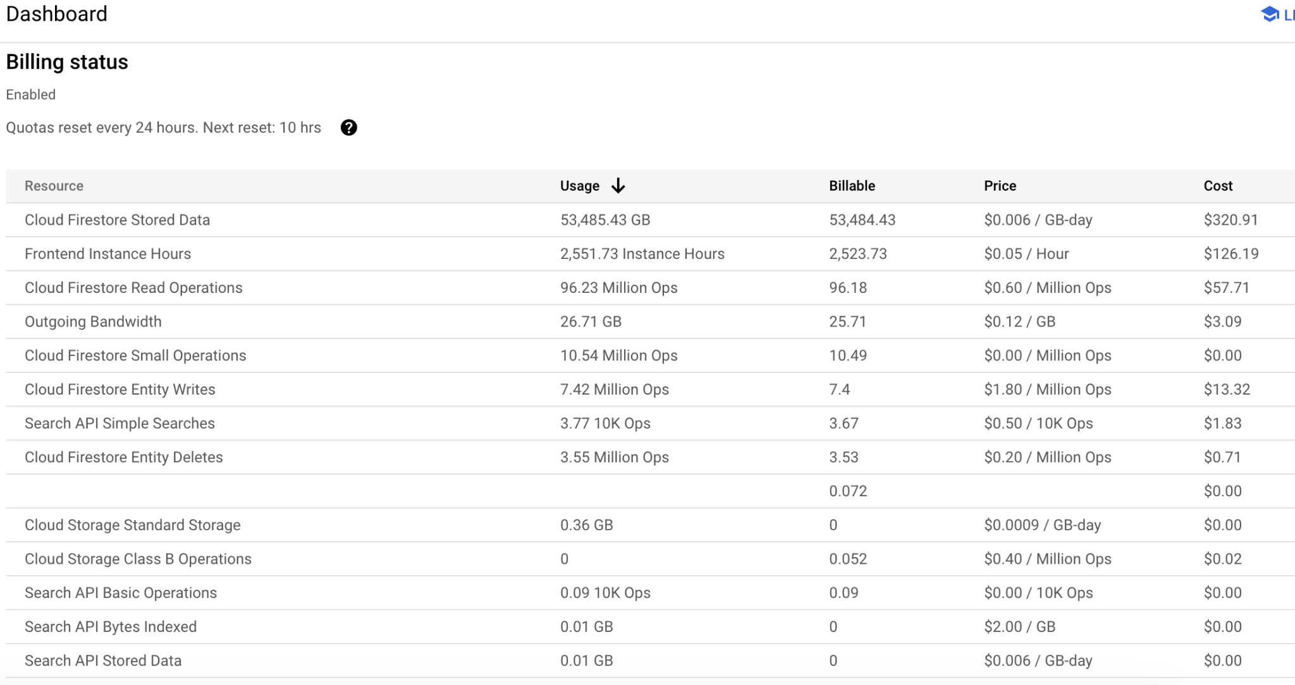
How are costs managed?
Notes:
Appengine has always had a real time usage dashboard - In the early days they supported daily quotas on the application - essential this was a kill switch for all traffic should something go off the rails - Unfortunately in production this meant someone had to catch a rapid increase, and then make the decision of downtime or fixing.

Slide 17
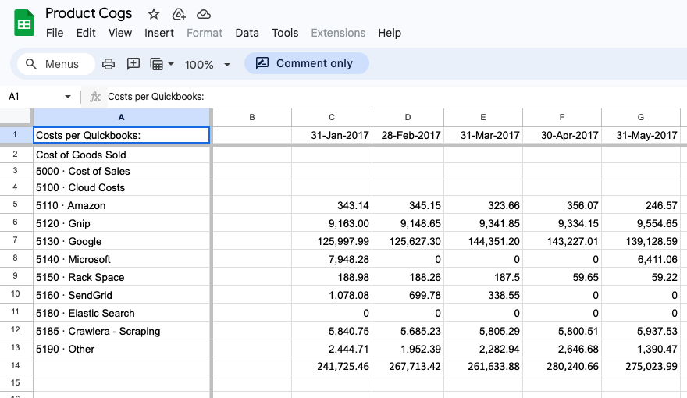
How are costs managed?
Notes:
Spreadsheets still rule the business landscape, its the one constant in onboarding acquisitions as well,

Slide 18
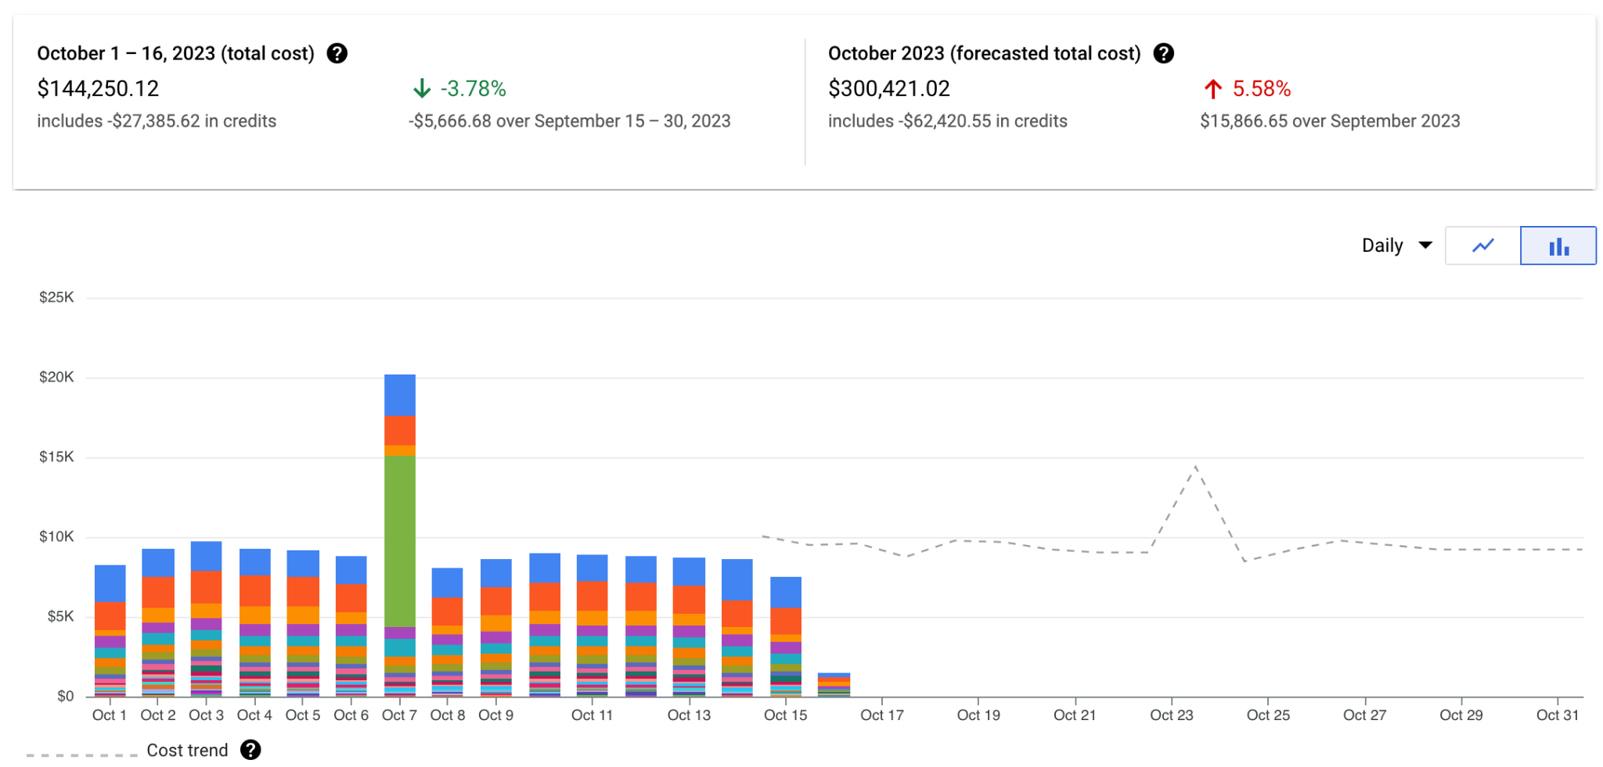
How are costs managed?
Notes:
Google provides some forecasting tools, but they are still pretty basic. Breakdown by project, Product, SKU and usage - These reports typically live at the org/billing admin level, but we do open these up for all developers. - You’ll see things like a 5% forecasted increase, this tends to cause panic among those who haven’t seen the reports before, but i look at this and immediately see “October is longer” - that means our fixed costs like Looker (green bar) and enterprise support contract (purple) will stay the same total, but we’ll have higher costs on the Compute engine (top blue bar) and the appengine (red bar)
Sanity check alerting - ie set a budget of what you expect to spend for the month - and send alerts at 50% - when that e-mail arrives tells you the pace of spend.

Slide 19
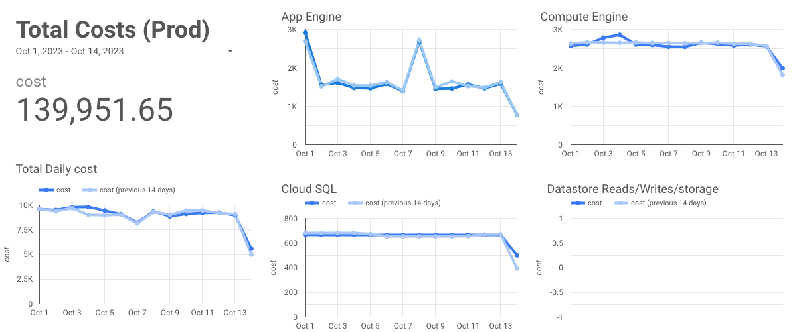
How are costs managed?
Notes:
Custom dashboards for information radiators around the office and specific views for teams.

Slide 20
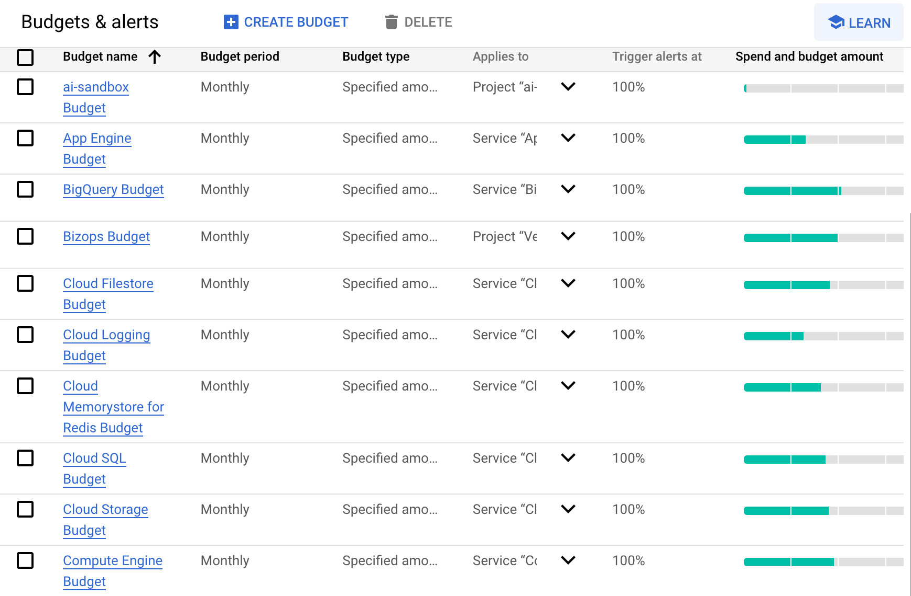
How are costs managed?
Notes:
Sanity check alerting - ie set a budget of what you expect to spend for the month - and send alerts at 50% - when that e-mail arrives tells you the pace of spend.

Slide 21
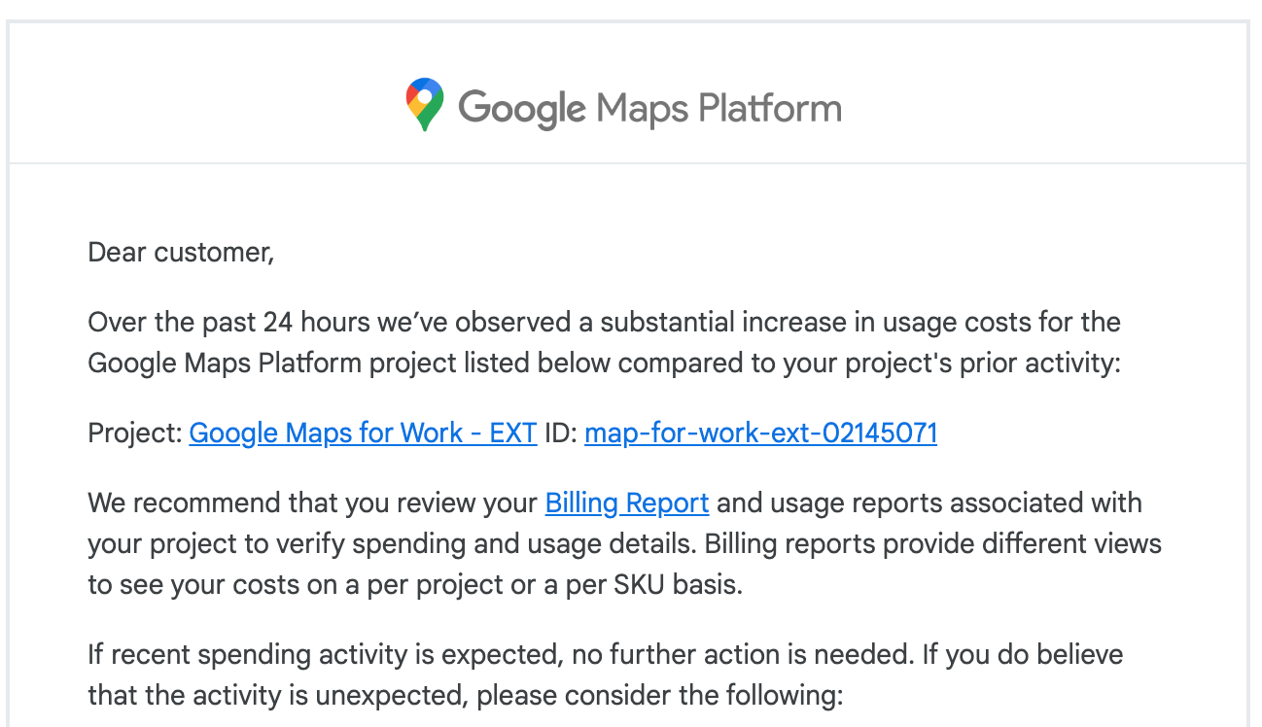
How are costs managed?
Notes:
In the end you don’t want to be getting these e-mails

Slide 22
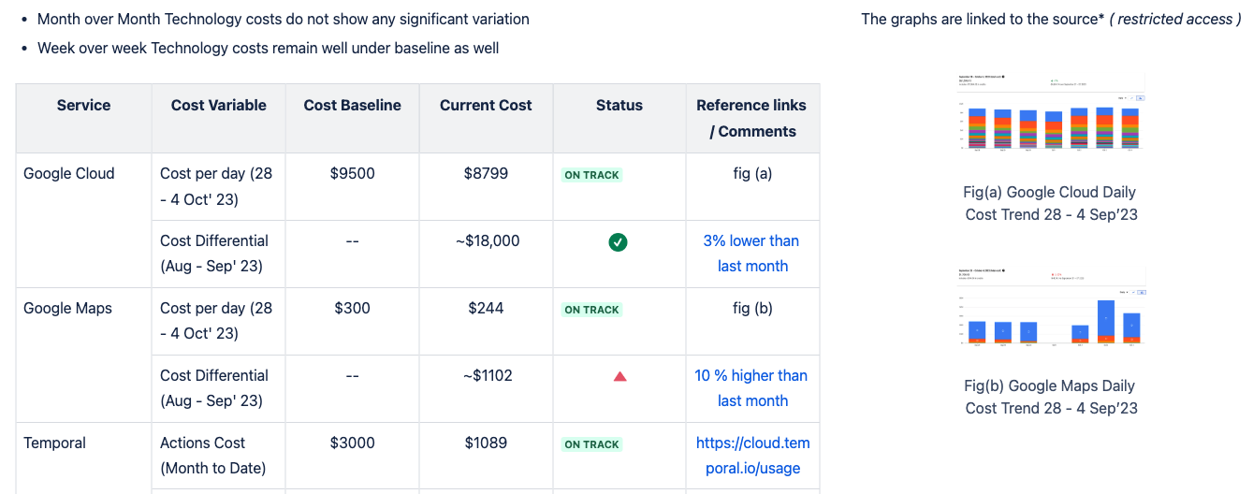
How are costs managed?
Notes:
Weekly review of metrics in a newsletter format
Monthly updates on margins and performance as part of tech demos by the CTO

Slide 23

How have others managed this gap?
Notes:
37 signals
Makers of basecamp (project management software)
Run the business in a really unique way - Profitable, predictable, no IPO asperations or investors to answer to.
Playing the long business value card
They claim the cloud is Bad deal for medium sized businesses with predictable growth
For context on medium size - they had a 215 million ARR in 2020
Great deal for startups that are low traffic and simple
Good deal for wildly fluctuating workloads. You’re paying a significant premium for having nearly unlimited compute at hand.
Exiting the public cloud, they figure its cheaper to run their own hardware in colocated datacenters themselves - Keep in mind this isn’t saying build a datacenter from scratch, leave that to the digital reality or equinix - but haveing the capacity to invest in hardware, experience, space up front - have predictable growth to accommodate what are long purchase cycles (networking gear specifically is over 18 months to delivery)
They also called out that most cloud providers have extended the lifespan of hardware over the last couple years - from 4-5 years for servers and 5-6 years for networking gear, this is contributing to their 30% margins
We spent $3.2m on cloud in 2022. The cost of rack space and new hardware is a total of $840,000 per year.
Leaving the cloud will save us $7 million over five years.
Back of napkin math - if their growth continued at previous rates the ARR is likely in the 235 million range - Spending $3.2 million on cloud would indicate this is an incredibly efficient operation, and squeezing that even further.
https://world.hey.com/dhh/why-we-re-leaving-the-cloud-654b47e0
https://basecamp.com/cloud-exit

Slide 24

What about a non growth environment?
Notes:
Indicators of incorrect architecture tend to be cost variances from budget
Incidents
Implementing new programs/tracking growth
Operations - opportunity cost is valued much differently here, more willing to spend effort in toil than capital expenses.
Saving grace in this area was virtualization - having only a few large capable servers allowed flexibility in resourcing and budgeting.

Slide 25
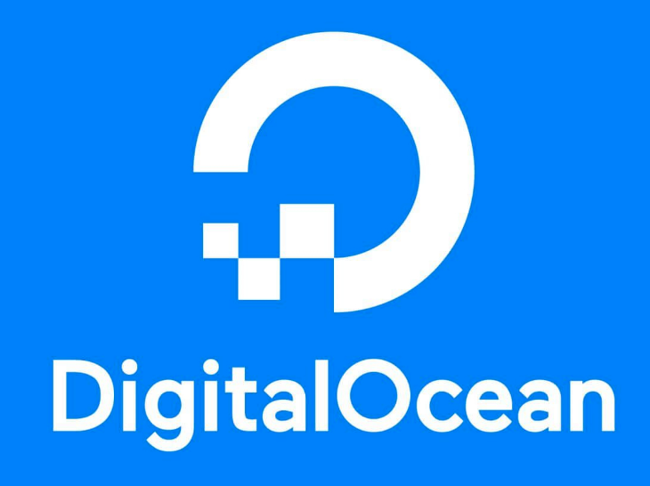
What about a non SAAS environment?
Notes:
Speaking of much needed flexibility and budgeting - originally provisioned hardware/bare metal no longer having a great load or traffic distribution, leading to hot spots, slow response to needs and much wasted capacity - This was a particularly acute problem within the storage systems space - Hundreds of servers, all provisioned for specific purposes - like running metrics collection, mounting disks of various types, running async tasks, snapshots, lifecycle management. Performed an in place Kubernetes install and workload migration, on existing hardware

Slide 26
Understanding business context is the most important step in making architecture decisions
Notes:
If you take one thing away from this talk - It’s to go learn about your business, its margins, its customers, its strengths and weaknesses, with this knowledge you can align your decisions and those of others around you to find what is the closest to an ideal architecture.

Slide 27


Dale Birtch
Engineering Manager
Vendasta
306-716-6741 dale.birtch@gmail.com

